Slide 1
Industry Baby:
Surfacing UAL Students’ (Mis)perceptions, hopes, and dreams related to Vocational Actor Training (VAT)

Slide 2
Educational Context:
BA Acting and Performance
UAL Wimbledon
Dr. Andrew Goldberg, PhD, MFA

Slide 3
Professional Context:
A changing landscape

Slide 4
Research Question:
What are UAL Acting Students’ professional dreams and aspirations (so that we as a staff can best support them in their career aspirations)?

Slide 5
Importance of Research Topic

Slide 6
“Too many actors, too few roles”
Gulbenkian Foundation Report (????)

Slide 7
“Too many actors, too few roles”
Gulbenkian Foundation Report (1975)
Wilkie (2015) - “A case for curriculum extension in UK vocational actor training”

Slide 8
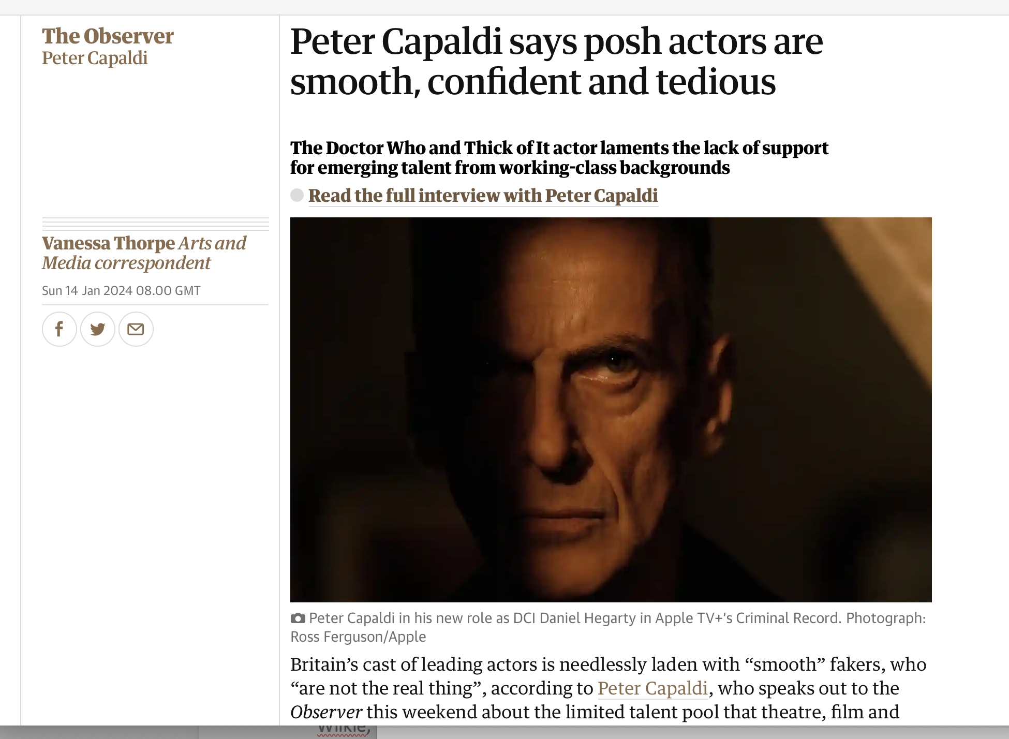
“Art is about reaching out. So I think it’s wrong to allow one strata of society to have the most access” - Capaldi as quoted in Thorpe (2024)

Slide 9
“The promise offered by training is therefore not simply the transmission of skills and craft but also access to aspiration.”
“Editorial on Training” - Richard Gough & Simon Shepherd (2009)

Slide 10
Research Methods: Goals
Access their hopes, dreams, aspirations, fantasies
Draw on their existing creative express capacities
Create a workshop, in the spirit of ARP, that would in and of itself serve the ends of the research goal

Slide 11
Structure of Workshop:
“Industry Baby” - Mind-mapping exercise
“Future Nostalgia” - Script writing and performance exercise
“Werk It” - Group Brainstorm

Slide 12
Recruitment
100 students invited (2nd and 3rd Years)
16 Accepted
8 attended
Workshop held: Wednesday, 29 November 2024 at UAL Wimbledon

Slide 13
“Industry” Mind Maps

Slide 14
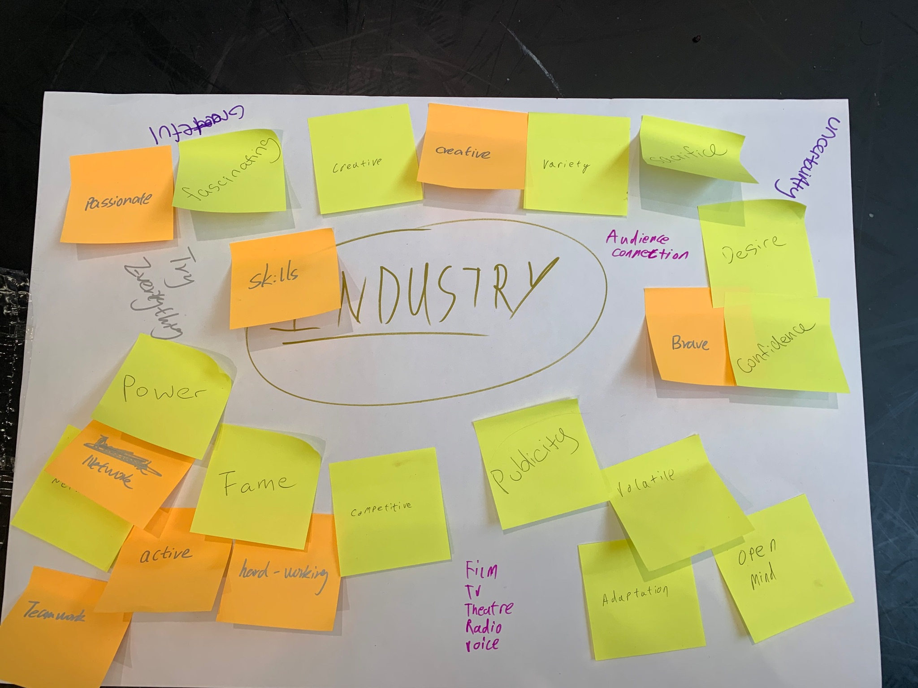

Slide 15
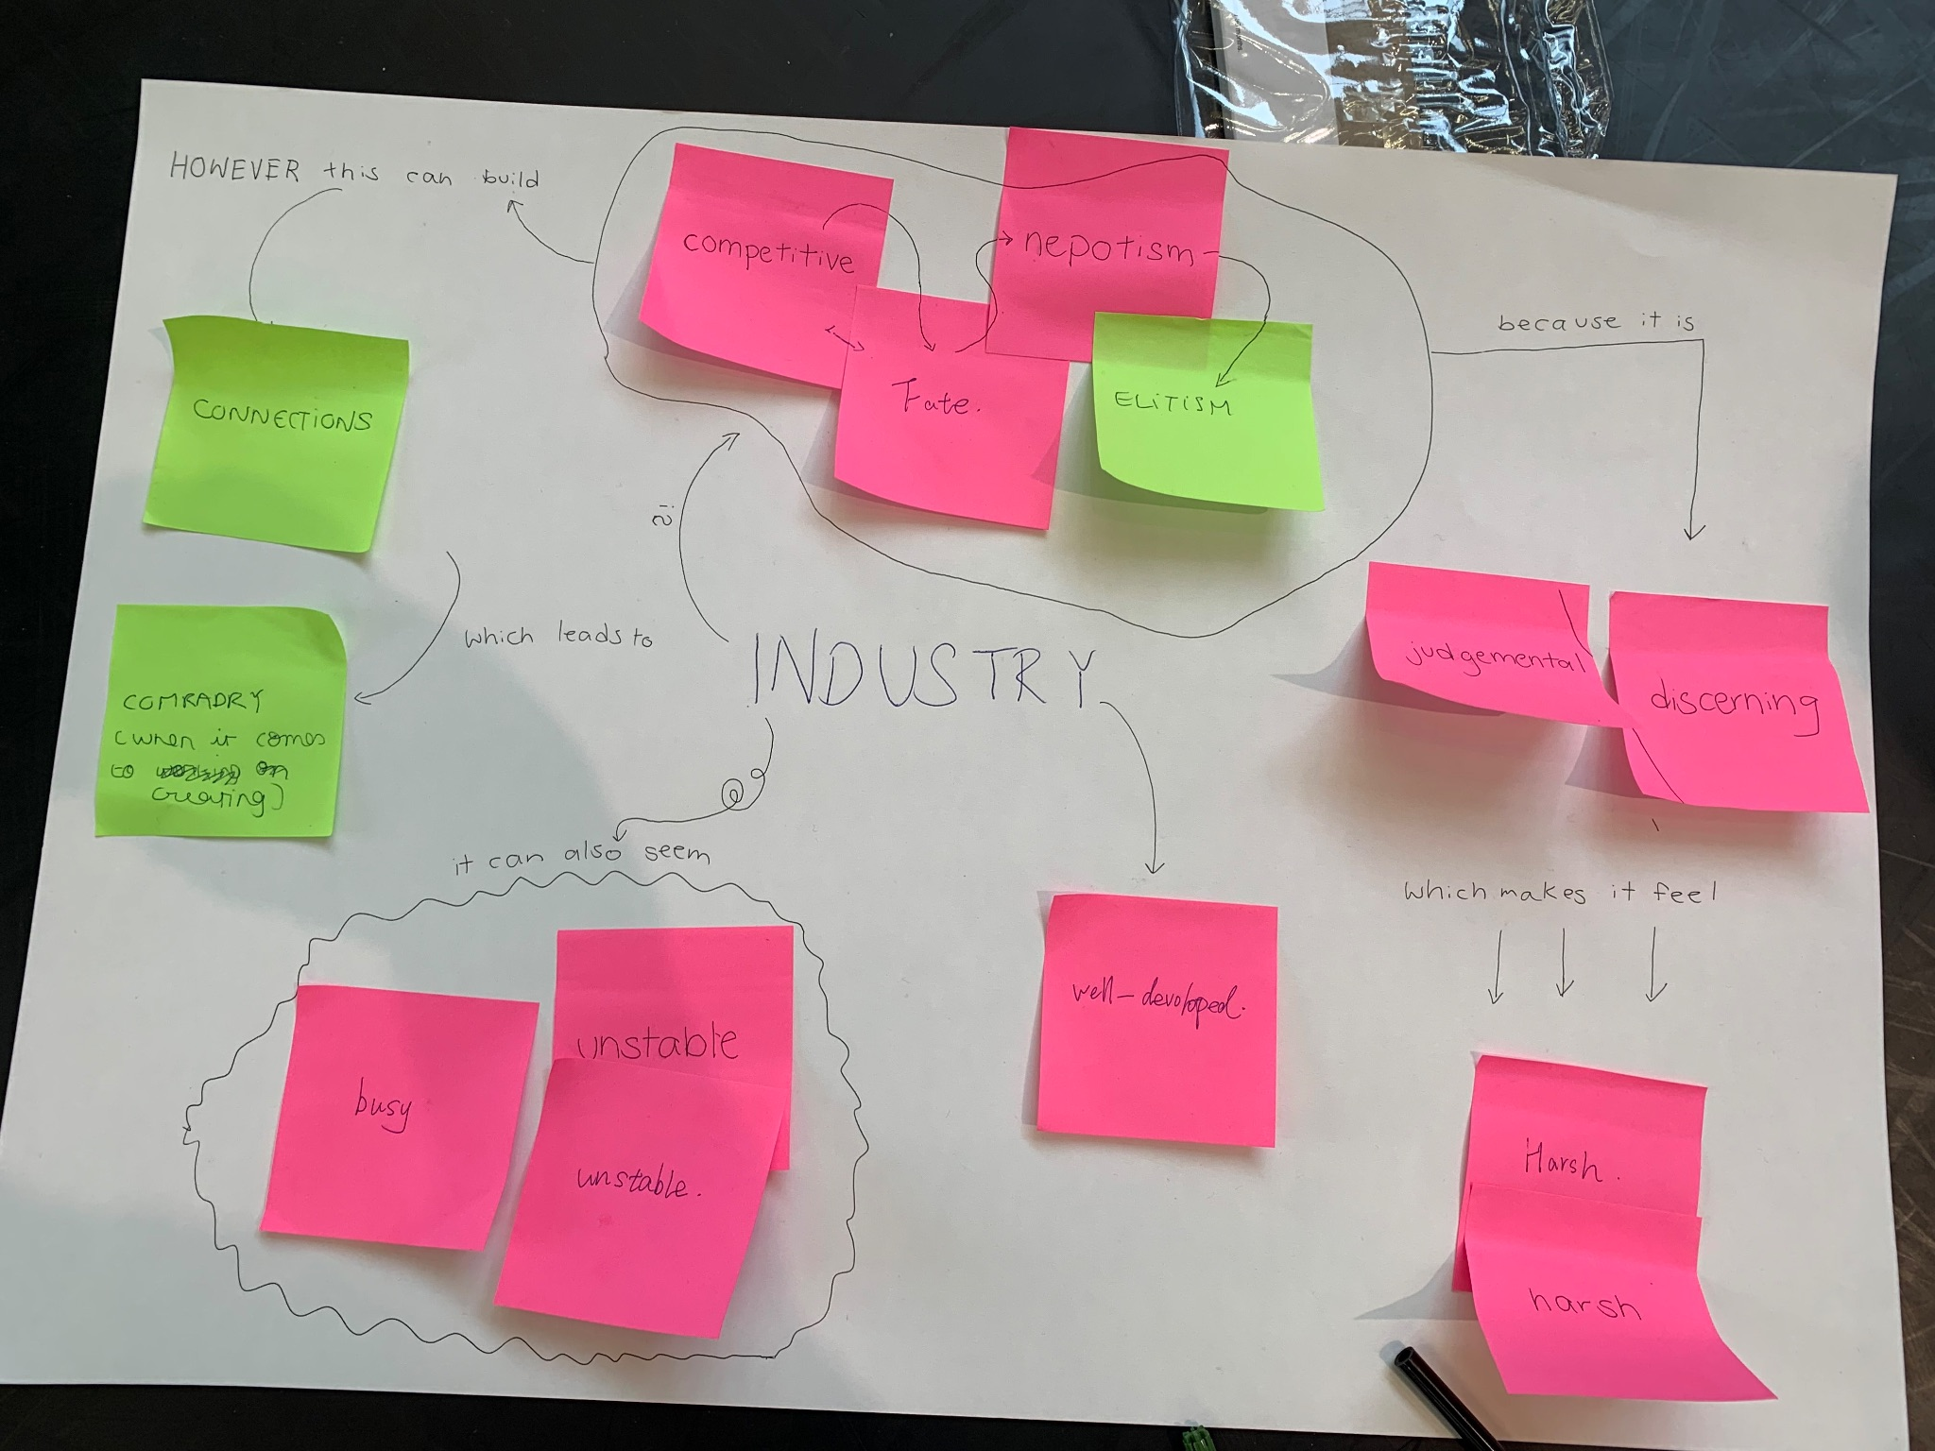

Slide 16
“Industry”
Connections (x2)
Elitism
Harsh (x2)
Unstable (x2)
Fate
Nepotism
Judgmental
Passionate
Skills
Creative (x2)
Fame
Uncertainty
Audiences
Confidence
Desire
Sacrifice
Power
Publicity
Competitive (x3))
Network (x2)
International
Big
Mixed
Mainstream
Alternative
The acting community

Slide 17
II. Interviews with Future Self

Slide 18
INTERVIEW WITH ____________________________________________
Interviewer: Congratulations on the success of your new project! Can you tell us more about it?
You:
Interviewer: Can you tell us more about your role in the project? What aspect is the most exciting for you?
You:
Interviewer: Wow, it sounds like this is exciting new territory for you artistically. How does this relate to your previous work? What past experience prepared you most for this?
You:

Slide 19
Interviewer: Can you tell us more about some of your collaborators on this project?
You:
Interviewer: Well, congratulations on all your success! What can we expect to see from you next?
You:

Slide 20
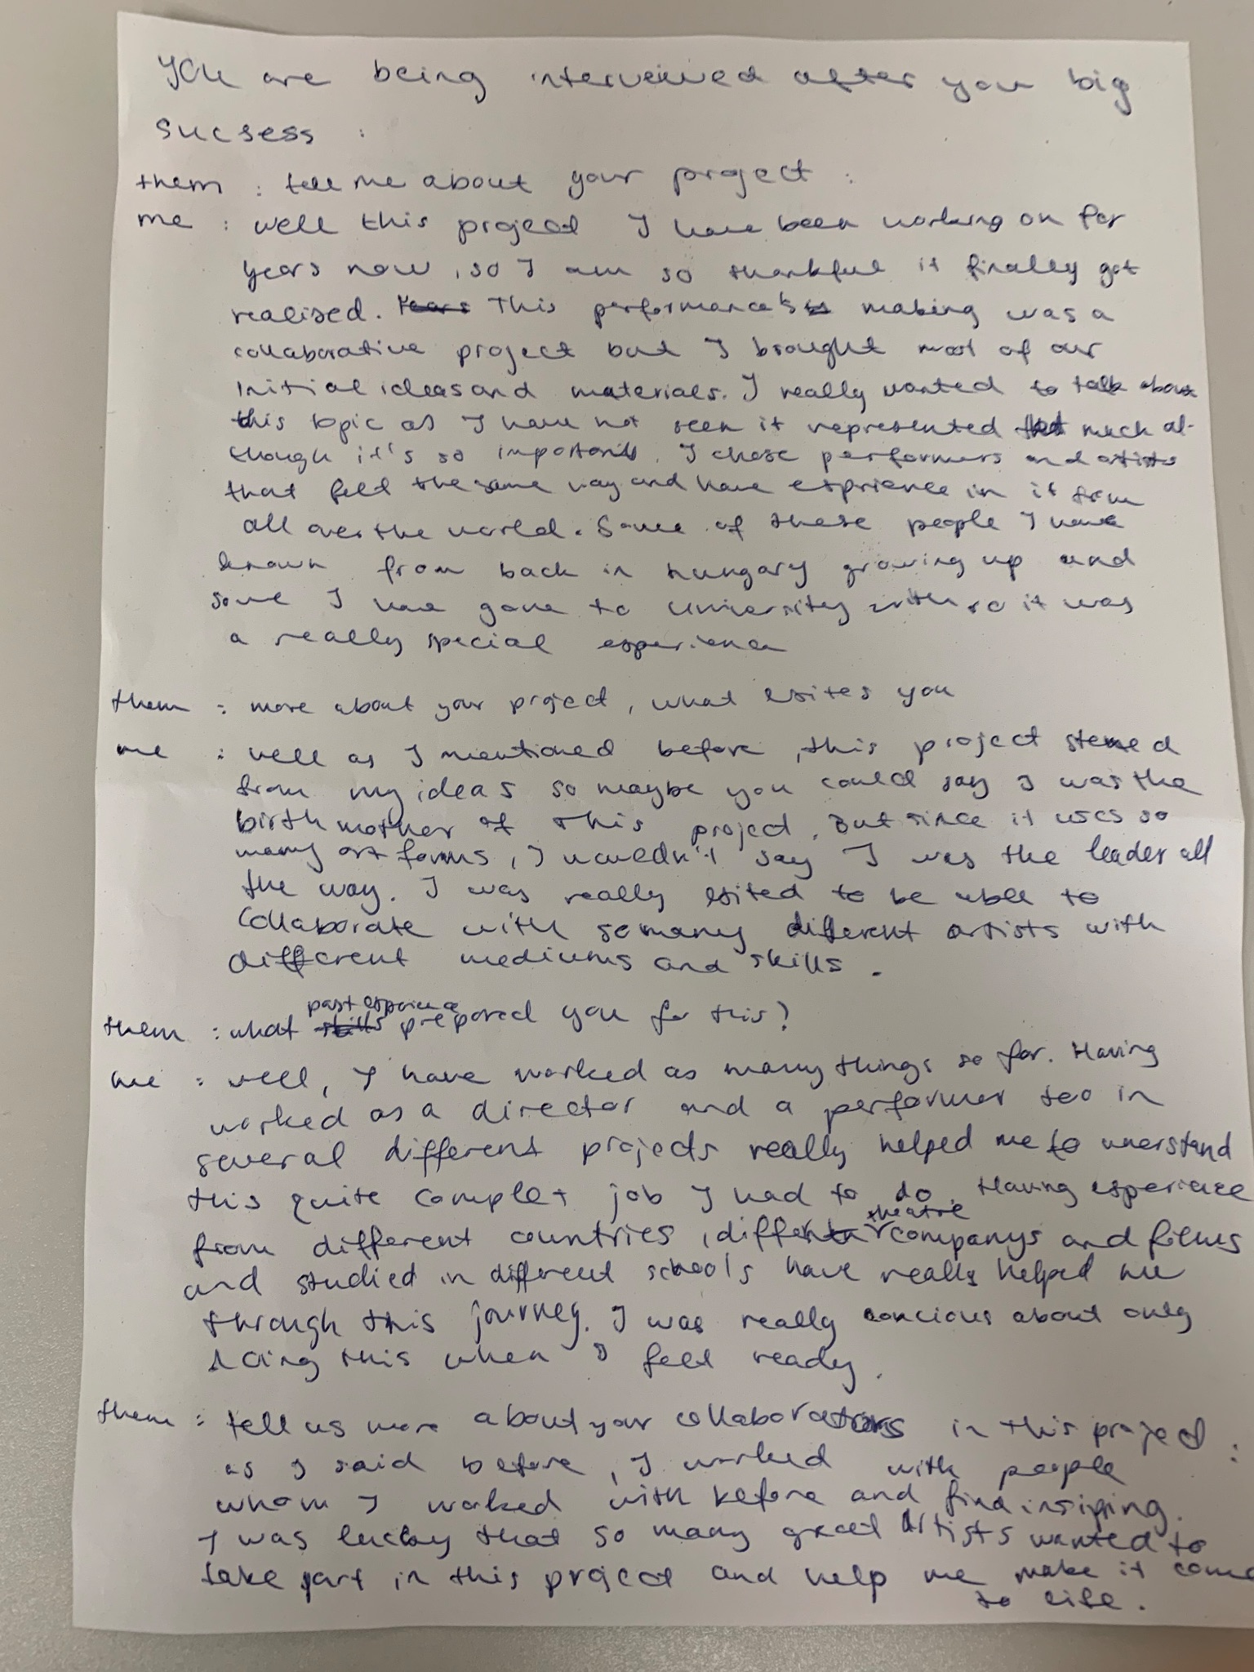
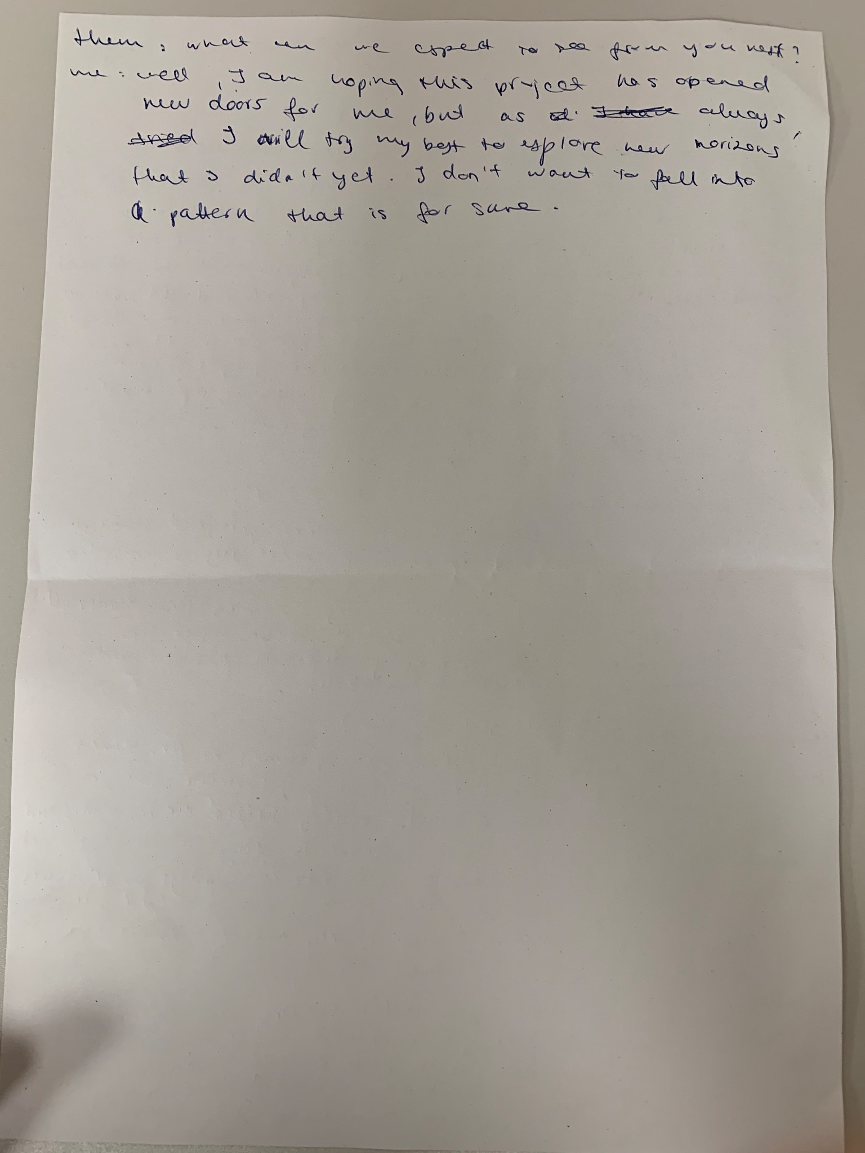

Slide 21
Future Dream Projects
Star in and Write a Big Budget Hollywood Movie (w/ Michelle Yeoh, directed by James Cameron)
Writer of Independent Art-house Film about young immigrant women
Curator of traveling Interdisciplinary arts event
Actor in a prestige, ensemble-driven film
Actor in an experimental film using robots and AI
Voice Actor for Video Games
Producer/Director of Film about Chinese culture
Producer (and Actor) of Intercultural Theatre Company bridging Easter/Western cultures

Slide 22
III. Brainstorm list of skills/experiences needed to get from here to there

Slide 23
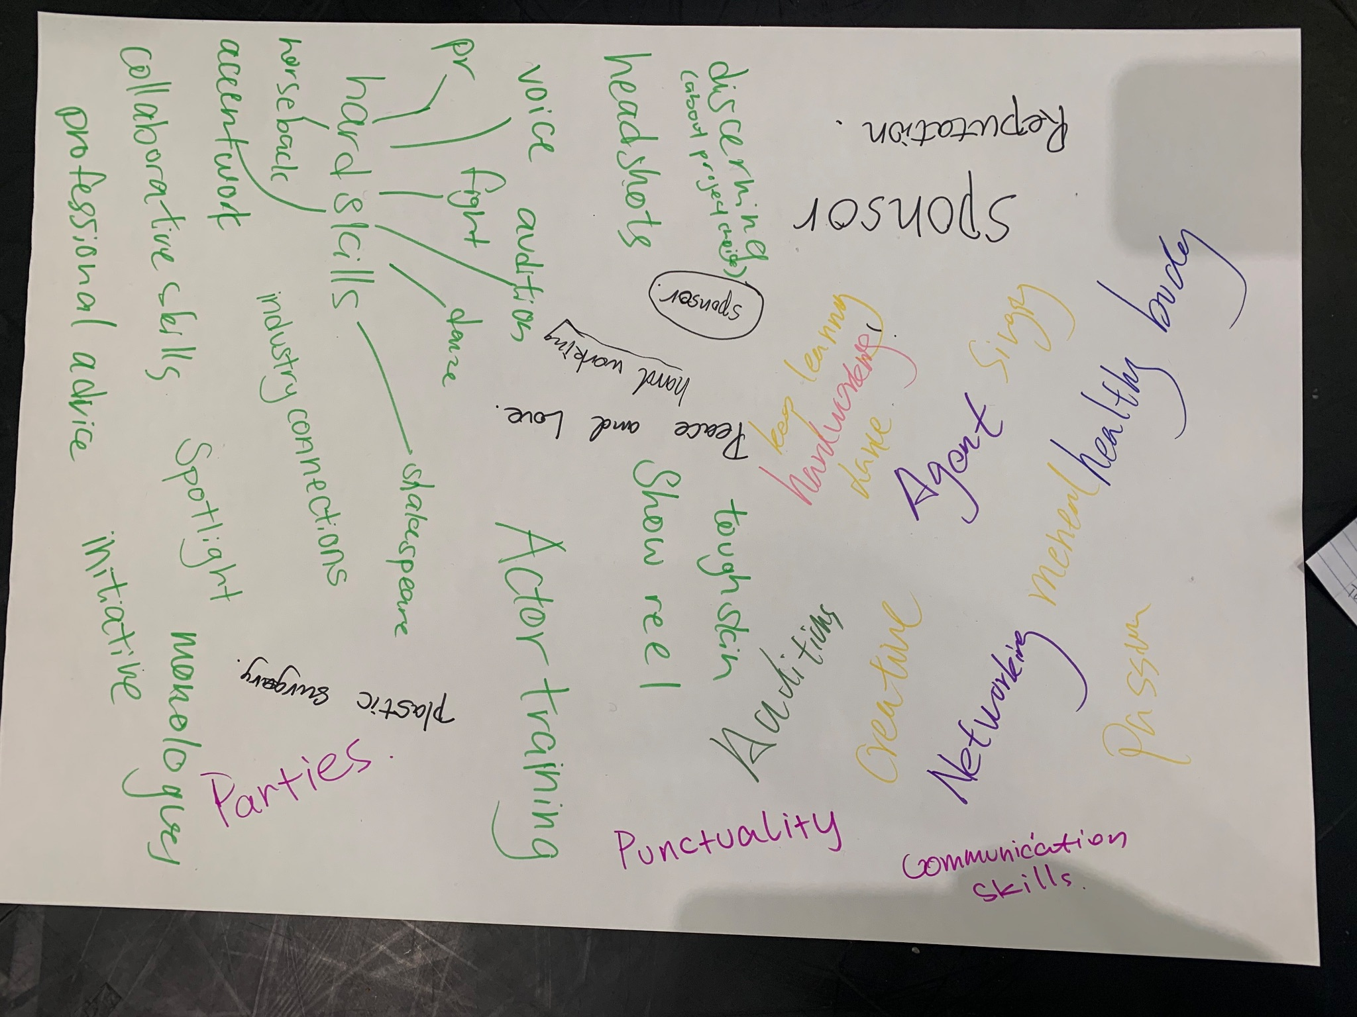

Slide 24
Want training in…
Voice
Movement
Audition Techniques
Script Work
Camera/Film Acting
Understanding Practitioners
Horseback riding
Collaboration
Accent Work
Communication Skills
Networking
Agent
Fundraising
Plastic Surgery
Peace and Love
Healthy Body

Slide 25
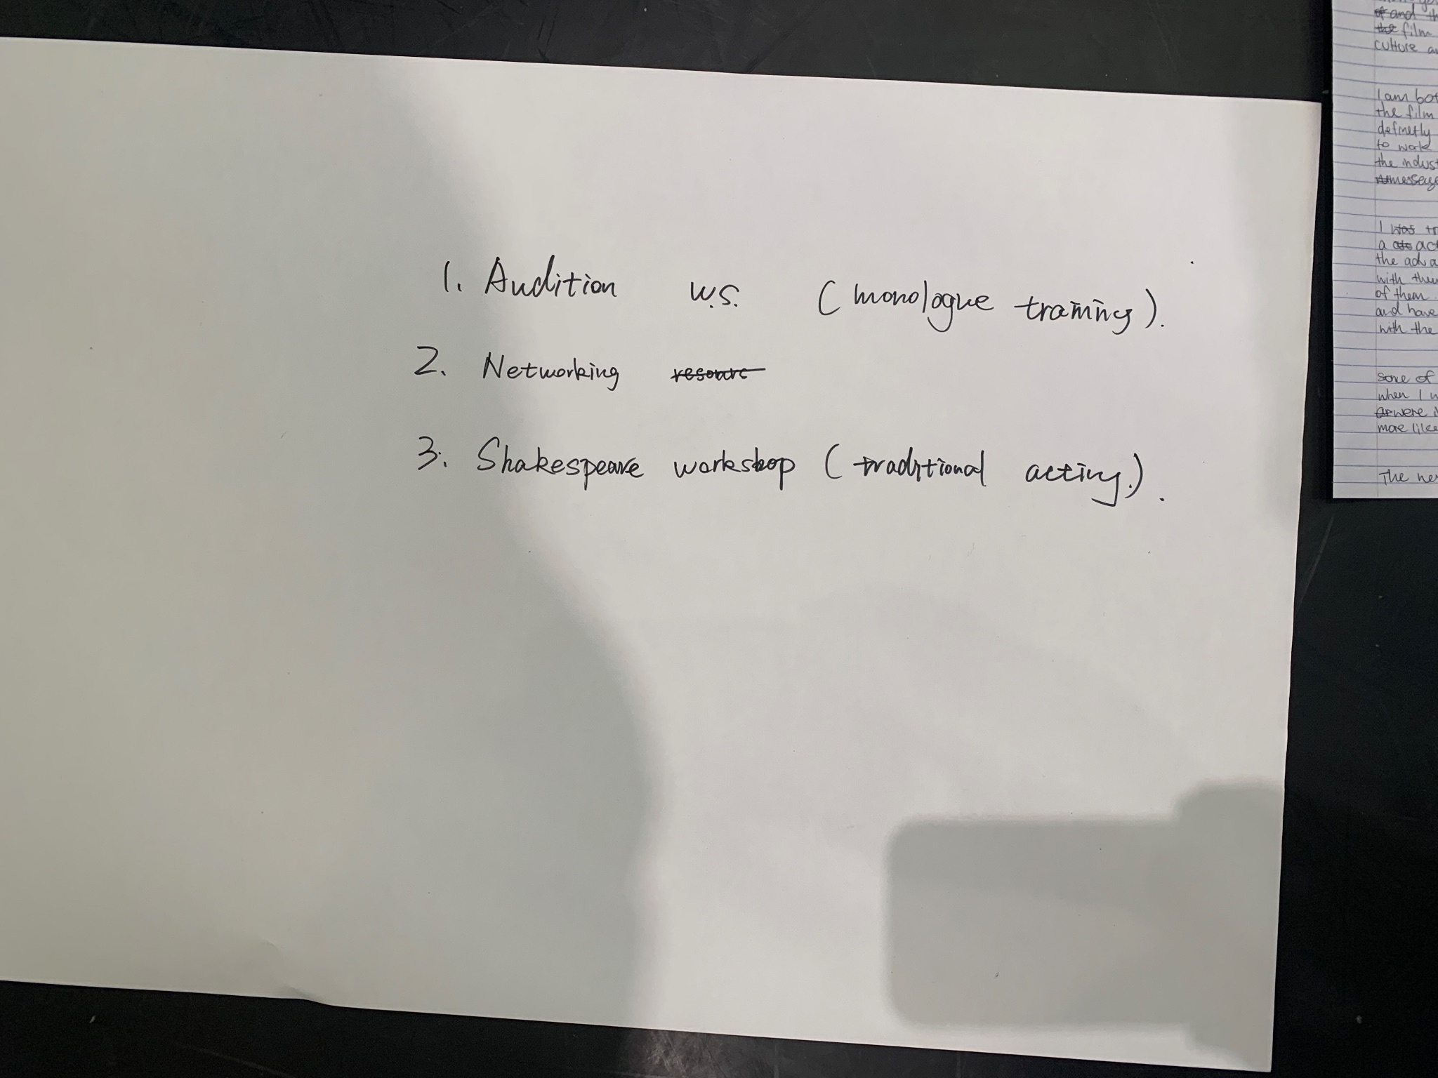

Slide 26
General Observations
Wide range of roles/media
Global Perspective
Strong emphasis on film and/or new technologies
Positive view of Acting for Stage as foundational to many future roles
Lack of professional role models
Missing vocabulary and/or perspective of necessary skills

Slide 27
“Portfolio Careers”
(Blackwood, et al. 2019)

Slide 28
Practical Next Steps
Embed this workshop in course curriculum
Discuss Workshop with Staff
Report back to student participants
Revise and enhance current professionalization activities
Find ways to encourage more attendance at live events

Slide 29
Future Research Questions
Are there different perspectives across the three years? Do the same students’ perspectives change over the course of the course?
Do our international students bring a different set of hopes/expectations?
Alumni perspectives

Slide 30
Thank you!
Questions?

Slide 31
Bibliography
Blackwood, E., Latukefu L., and Seton M. (2019) “Actor training in portfolio careers: Flourishing in a creative career beyond ‘luck’” fusion journal (15), pp. 18-26.
Gough, R. and Shepherd, S. (2009) “Editorial on Training,” Performance Research, 14(2), pp. 1-2.
Jokela, T. and Huhmarniemi, M. (2018). “Art-based action research in the development work of arts and art education.” The Lure of Lapland: A handbook of Arctic art and design.
McNiff, J. (1995). Action research for professional development (pp. 137-151). Bournemouth, UK: Hyde.
Thorpe, V. (2024) “Peter Capaldi says posh actors are smooth, confident and tedious,” The Guradian, 14 January. Available at:
https://www.theguardian.com/tv-and-radio/2024/jan/14/peter-capaldi-says-posh-actors-are-smooth-confident-and-tedious
Wilkie, I. (2015). “’Too many actors and too few jobs’: A case study for curriculum extension in the UK vocational actor training,” London Review of Education, 13(1), pp. 31-42.

